Slide 1
GPU-based Global Drone Localization
Jizhou Yan

Slide 2
Agenda
Overview
Data Collection
Proof of Concept
Further Work

Slide 3
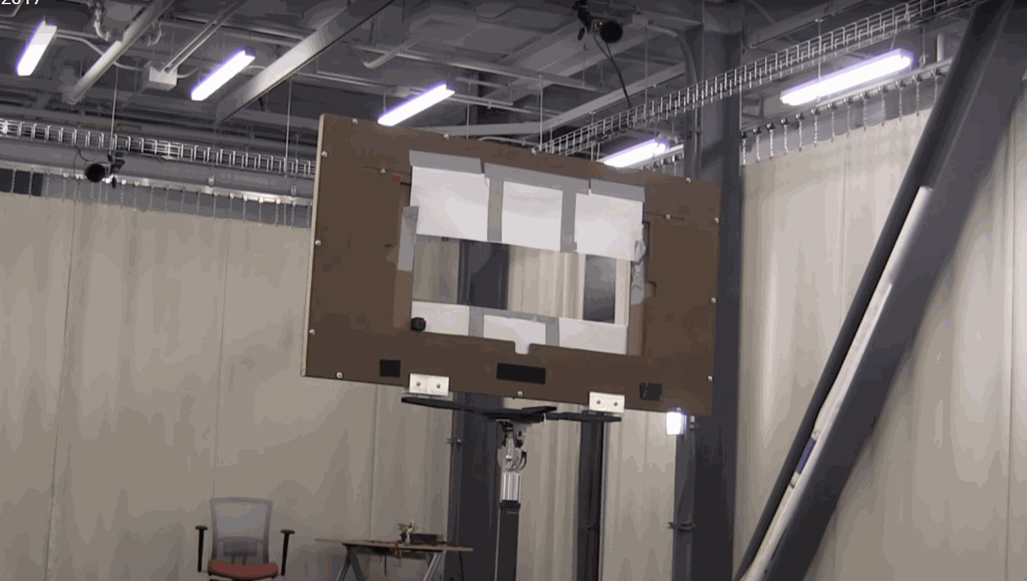
Overview
Localization is required for auto-navigation
Typical vision-based localization method:
Capture Image Frame
Feature detection
feature matching
Estimate Camera Pose

Slide 4
Data Collection
GRASP Lab
Scene Data: 500+ images, build with Structure-from-Motion
Test Data: 100 images
Ground truth: motion capture system

Slide 5
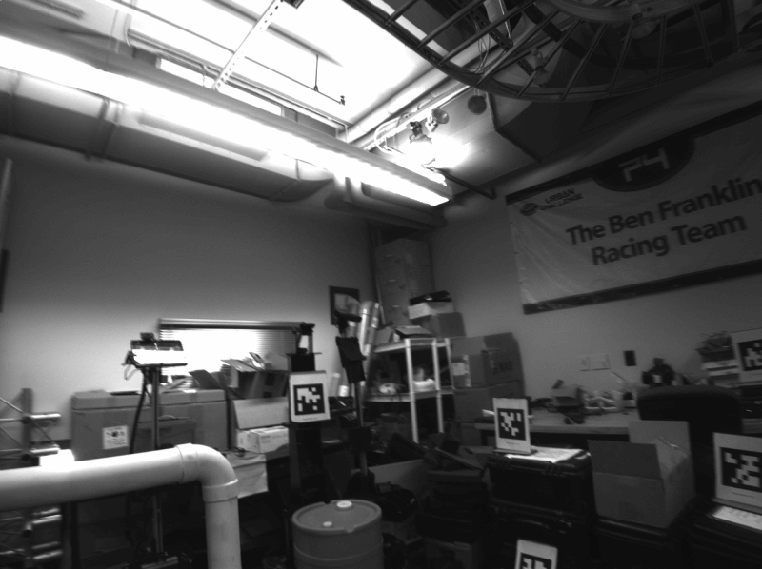
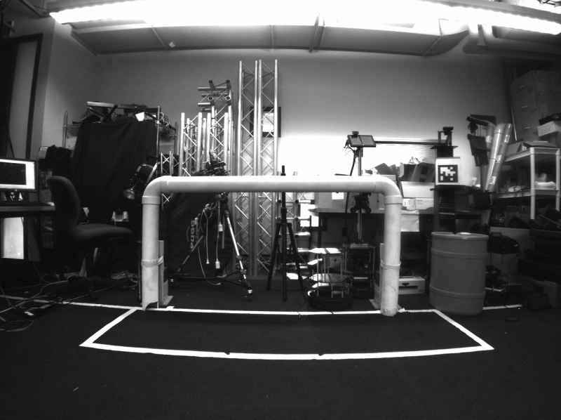
Data Collection
Scene Data Test Data

Slide 6
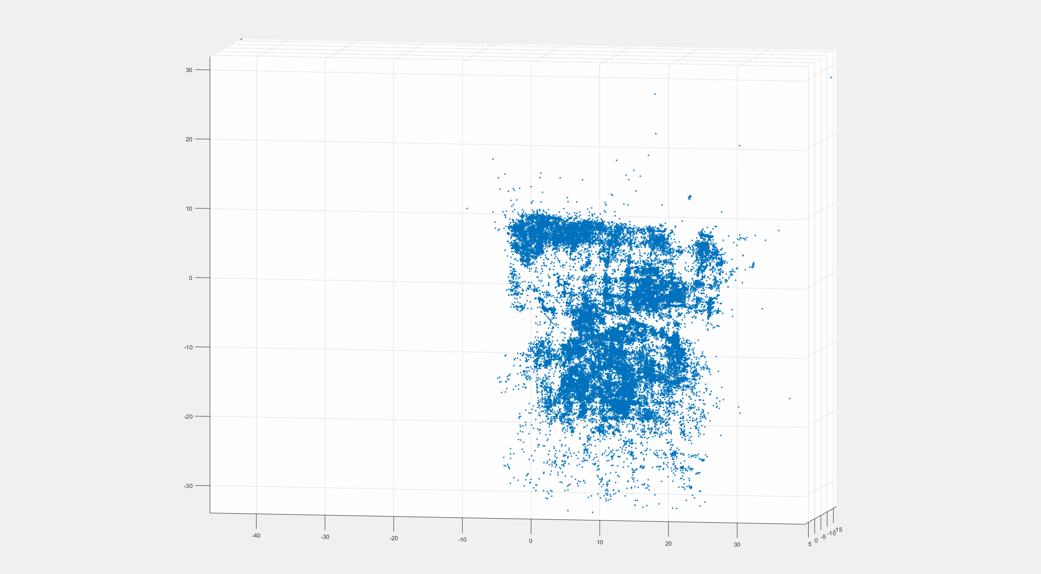
Data Collection
3D feature point cloud

Slide 7
Proof of Concept
On-board work flow
Extract SIFT feature
Feature matching
linear method to estimate camera pose (PnP)
Non-linear method to estimate camera pose
Using OpenCV SIFT (cpu) & KD-Tree
Own implement of PnP and non-linear optimization

Slide 8
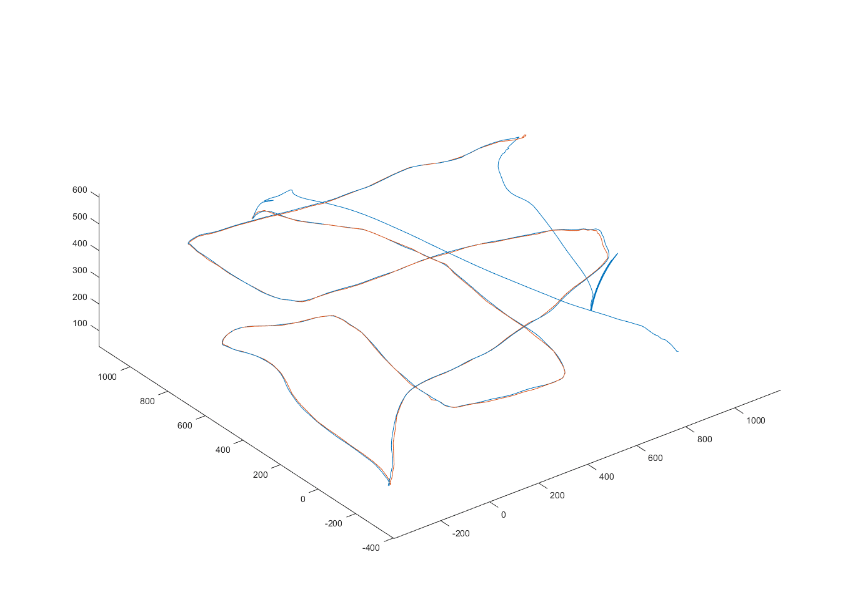
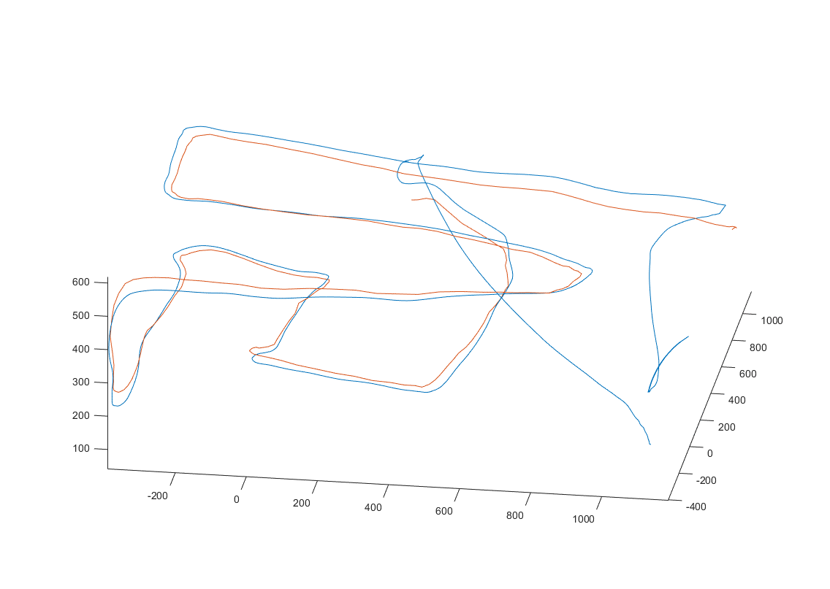
Proof of Concept
Compare with mo-cap data

Slide 9
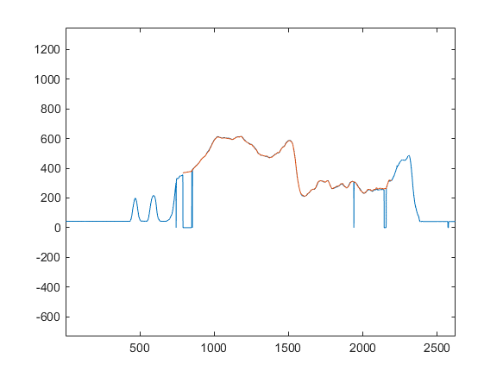
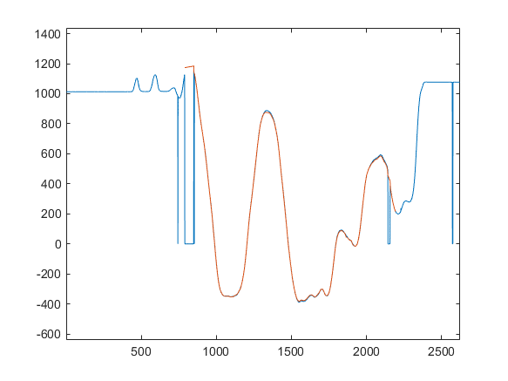
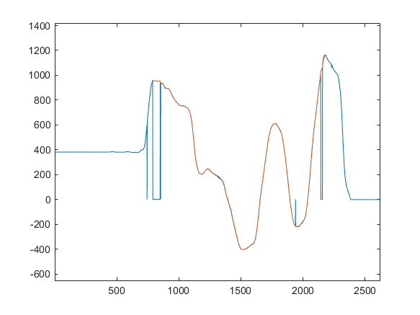
Proof of Concept
Compare with mo-cap data
Error: 11.51mm

Slide 10
Further Work
Implement and evaluate SIFT feature extraction

